Slide 1
Module 40: Deploying Workflow Processes
Siebel Core Developer and Technology School
Notes:
Time: Lecture: 30 – 45 minutes; labs: 40 – 50 minutes
Intent: To describe the process for testing workflows using the workflow Simulator.
Flow: The module begins by describing the necessary steps to prepare for simulation, which includes validating the workflow process, and verifying that the debug options are correctly set. Next, students learn the steps to use the workflow process Simulator. The module concludes with explaining the deployment process that begins in Siebel Tools, and completes in the client application.
Key Terms:
Simulator
Validate
Test data
Deploy
Activate
Migrate
Please note: Faculty-specific notes are italicized.

Slide 2

Module Objectives
After completing this module you will be able to:
  Describe the simulation architecture
  Test a Workflow process using the simulator
  Describe the steps for deploying a Workflow process
Why you need to know:
  Test any new or modified Workflow processes before they are deployed
  Follow specific deployment steps to successfully deliver Workflow processes to a production environment

Slide 3
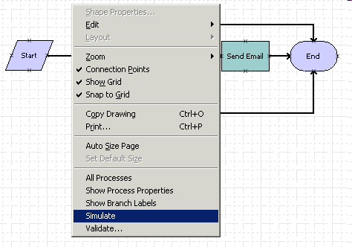
Performing Workflow Simulation
Simulate a Workflow process to verify that it performs as desired
Notes:
Simulation should be used whenever possible before a workflow processes is deployed. Iterative simulation can be used to test long and complex workflows—build the workflow in pieces and test each piece before putting the entire workflow together.

Slide 4
Preparing for Workflow Process Simulation
0/4
Understand Simulation Architecture
Verify Environment Requirements
Configure Siebel Tools
Validate the Workflow Process
Notes:
This is a positioning slide. The following slides describe activities that developers need to understand and complete before they use the workflow Simulator.

Slide 5
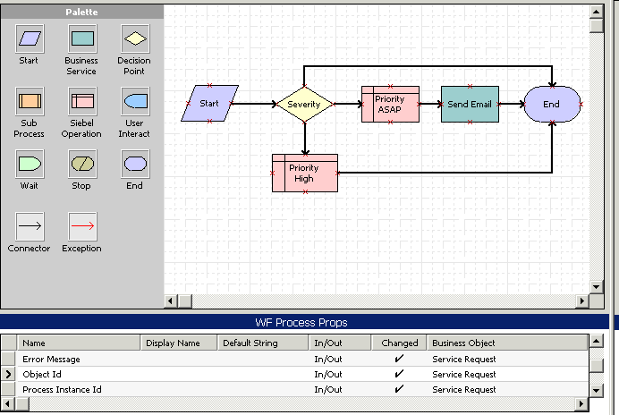
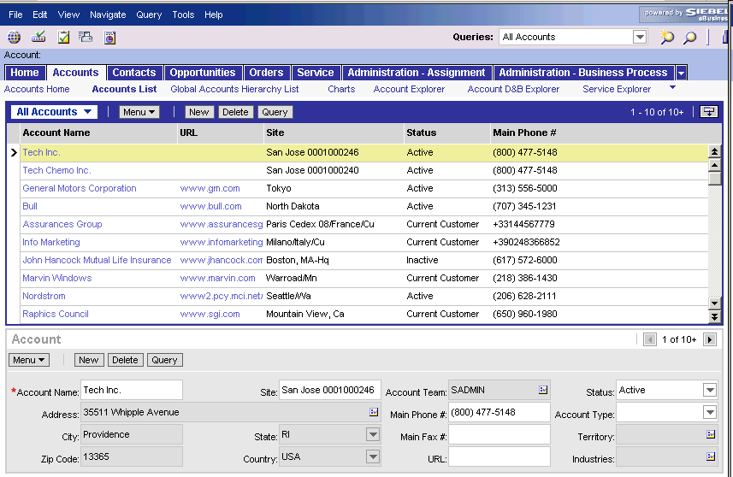
Understand Simulation Architecture
1/4
Simulation is initiated in Siebel Tools but runs in the Mobile Web Client
Mobile Web Client
DB
Workflow definition includes process properties
Workflow definition stored as a repository object
Notes:
The Workflow process simulator is hosted in Siebel Tools. When the simulator starts, the Mobile Web Client launches and reads the Workflow definition, including the process properties, as a repository object in the database. In this diagram, the Workflow process and its process properties are displayed on the left side. All this information is available to the Mobile Web Client, show on the right, so that each step in the process can be simulated in the Siebel application. The setup involved in making sure the simulator runs correctly is explained in the next few slides.

Slide 6
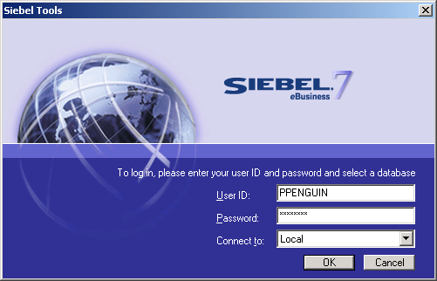
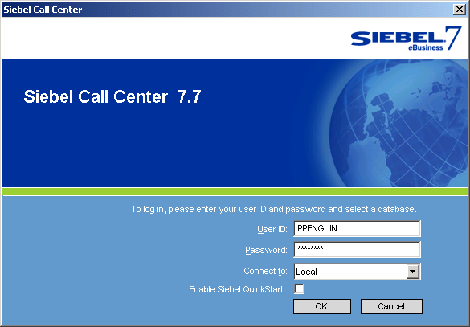
Verifying Environment Requirements
2/4
Siebel Tools and the Mobile Web Client must point to the same database
Siebel Tools
Mobile Web Client
Siebel Tools and Mobile Web Client both logged into Local database
Local DB
Notes:
The Workflow simulator provides communication between Siebel Tools and the Mobile Web Client which is installed locally on the same machine. Therefore, to run the simulator, both Siebel Tools and the Mobile Web Client must be installed on the same machine. In addition, both Siebel Tools and the Mobile Web Client need to be connected to the same local database, either Sample or Local. Connecting to the Server database isn’t feasible since it is not typically installed in the same environment where you will be doing your development.

Slide 7
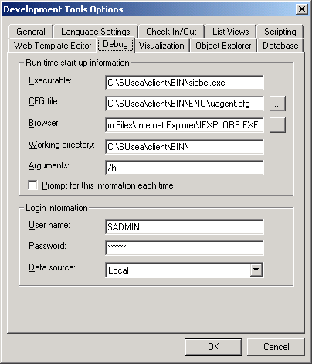
Configuring Siebel Tools
3/4
Set up Debugger to launch the Mobile Web Client
Select View > Options > Debug
Executable: Location of the siebel.exe file for the Mobile Web Client
CFG file: Location of the Mobile Web Client configuration file
Working directory: The Mobile Web Client directory
Arguments: Use default, opens communication between Tools and Mobile Web Client
Login Information: Login name, password, data source
Notes:
Like the Debug tool, the Simulator uses the run time client for testing purposes. To set up the Simulator, go to the Debug options in Siebel Tools. Locate both the siebel.exe file and the configuration file for the Mobile Web Client, and enter the directory path information here. Specify the working directory, which is the root directory where the dll files for the Mobile Web Client reside. Select the directory path for the Web browser, and use the default value in the Arguments field. In this case, “/h” is the argument used to enable local debugging. In the login information section, enter a username and password that will work for the Mobile Web Client. This user must have access to the views that are used in the Workflow process. And finally, specify either the Local or Sample data source as appropriate.

Slide 8
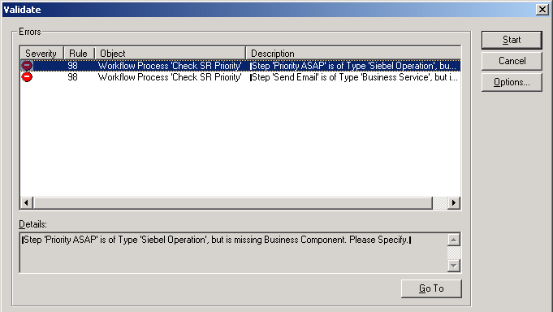
Validating the Workflow Process
4/4
Validate Workflow processes before simulation and deployment
Right-click the design canvas, select Validate
Click Start to validate
Error list
Error detail
Notes:
Validation is an error correction mechanism. Run Validate before simulating a workflow process to make sure that each step is configured correctly. Keep in mind that validation primarily checks syntax -- if a Workflow process passes validation with no errors, it does not guarantee that the Workflow will work successfully.
In this screenshot, the first error explains that the Priority ASAP Siebel Operation step is missing a business component. In the second error, the Send Email Business Service step is missing a Business Service Method. By correcting these two errors prior to simulation, you can make sure that the simulation won’t fail due to missing information in steps. To validate a workflow process, right-click in the design canvas to open the context-sensitive menu, then select Validate. Alternatively, you can right-click a Workflow process in the Object List Editor and select Validate. Once the Validate dialog box opens, click the Start button. If no errors appear in the list, and a message appears in the lower-left corner of the dialog box saying “Total tests failed: 0,” then the workflow process has no errors.

Slide 9
Using the Workflow Process Simulator
0/5
Specify Test Data
Select Simulator
Start Simulation
Start Workflow Engine
Verify Workflow Progress
Notes:
This is a positioning slide. The following slides describe how to perform a simulation of a workflow process.

Slide 10
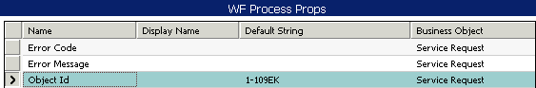
Specify Test Data
1/5
Create test records to support the simulation
Enter the Row ID as a process property in Siebel Tools
  Object ID is normally passed into workflow by the application
  Since the simulator is running, you need to provide the Object ID
Row ID of the test record
Notes:
Prior to running the Simulator, create a test record in the local client. Enter the row ID for the test record as the Default String for the Object ID property.

Slide 11
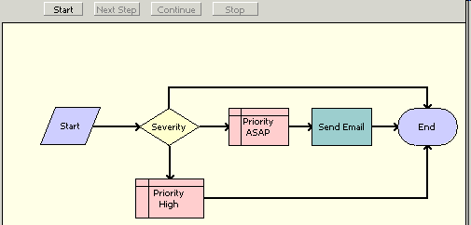
Select Simulator
2/5
Right-click the design canvas and select Simulate
Simulation buttons
Notes:
The Workflow process Simulator is accessed by using right-click in the design workspace, then selecting Simulate from the context-sensitive menu. Alternatively, you can right-click a Workflow process in the Object List Editor and select Simulate Workflow Process. The Workflow process is then displayed in read-only mode (indicated by the yellow background), and the simulation buttons appear.

Slide 12
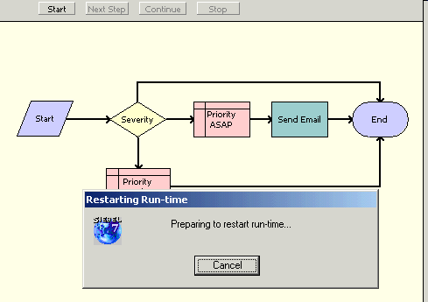
Start Simulation
3/5
Click Start
  New instance of the runtime client launches according to debug settings
  Navigates user directly to My Inbox Items View
Notes:
To start the simulation, simply click the Start button. If the Debug options are set up correctly, a dialog box appears indicating that the runtime instance, which is the Mobile Web Client, is starting. You should also see the client start, with the login steps managed by the debugger. Once the Mobile Web Client application is running, you will be navigated directly to the Inbox view.

Slide 13
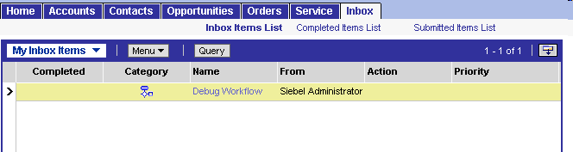
Start Workflow Engine
4/5
User must drill down on the workflow process to start Workflow Engine
  After a few seconds the Workflow engine is invoked
Drill down on Debug Workflow hyperlink
Notes:
The Inbox displays the Workflow process as a record called Debug Workflow. In the Mobile Web Client, drill down on the Debug Workflow record to invoke the Workflow engine. You can then go back to Siebel Tools to step through the Workflow process using the simulator.
In some instances, it is necessary to refresh the query in the Inbox in order for the Debug Workflow record to appear. The lab instructions provide steps for refreshing the query.

Slide 14
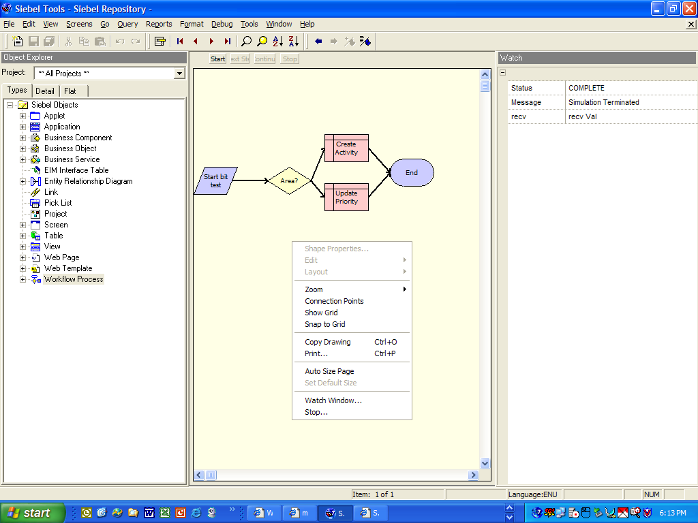
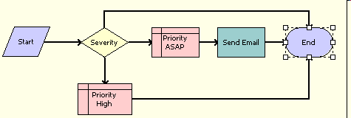
Verify Workflow Progress
5/5
Navigate back to Siebel Tools to continue with simulation and use the Watch window
  Use Next Step, Continue, Stop buttons
Watch window displays progress
Right-click to access Watch window
Notes:
Once the Workflow engine is invoked, return to Siebel Tools to step through the Workflow process using the Next Step, Continue, and Stop buttons. The Watch window displays process properties and their values at each step in the process. If the Watch window does not automatically display, right-click the workspace to open the Watch window.
In the lab instructions, you are asked to click the Simulation Stop button once the simulation completes, then again use right-click > Stop to return to the design canvas. Using this "stop-stop" technique ensures that the workflow simulation is complete before verifying results.

Slide 15
Simulator Considerations
Must use both Mobile Web Client and Siebel Tools for simulation
Cannot simulate processes that require running server components such as
  Assignment Manager, Communications Manager
For processes with user interact steps, use the Mobile Web Client to perform the action that will resume the process
Notes:
The simulation architecture for Siebel 7.7 does have some limitations. You have already seen how the Simulator requires an install of both Siebel Tools as well as the Mobile Web Client. Additionally, because you must run the debugger with a local install of the Siebel application, the Mobile Web Client, you cannot simulate processes which require a server component such as Assignment Manager, Workflow Process Manager, Communications Manager, or other components. Finally, for processes that have user interact steps, you will have to assist the simulation by going to the Mobile Web Client and clicking the appropriate button or whatever user interaction is required to continue the process. The corresponding restriction is that you cannot simulate a process that has a runtime event on the Start step. You can still test the process by removing the runtime event from the process for simulation and test all the steps in the process without the runtime event.

Slide 16
Deploying Workflow Processes
Two-step process separates the role of deployment from design
  Developer completes Workflow configuration in Siebel Tools
  Administrator activates from the Workflow Administration View in runtime client
Notes:
With the Business Process Designer now in Siebel Tools, deployment is a two-step process based on role: developer and administrator. Once the developer has completed creation or modification of Workflow processes in Siebel Tools, the administrator can then activate the Workflow processes in the runtime client. The benefits to this two-step process are that there is now more control on production processes, and the administrator can now change deployment parameters in the runtime client without relying on a developer's skill set.

Slide 17
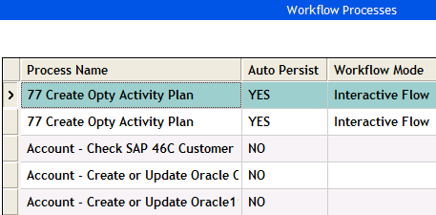
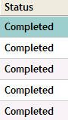

Developer: Deploy
Click Deploy button in Siebel Tools to make the definition available for activation
1. Deploy button marks flows Completed
Repository definition updated in Tools and client
Repository
Notes:
The diagram on this slide explains the deployment architecture and process. After validating and simulating the Workflow process, the developer clicks Deploy from Workflow Process List editor in Siebel Tools. This marks the Workflow process as Completed and updates it in the Repository table, as shown in step one on this diagram.

Slide 18
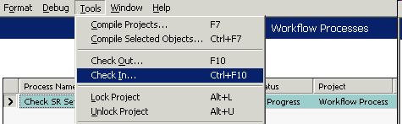
Developer: Check In
Check in Workflow process definitions to the master database before deployment
Notes:
After clicking the Deploy button to mark the workflow as Completed, the developer should check in the project. As developers, all development work should be done in Tools in a local database and should never be logged directly into the server database from Tools. However, if the developer is logged into the server database while deploying Workflow processes, the completed processes are immediately available in the runtime client for activation once the Deploy button is clicked.

Slide 19
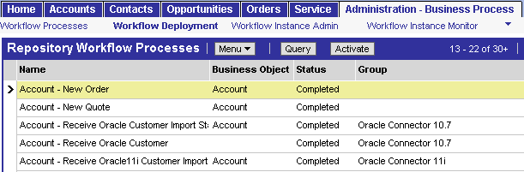
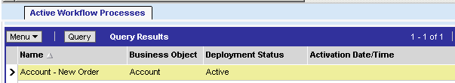

Administrator: Activate in Web Client
In the Web Client, click Activate to finalize the deployment process
1. Deploy button marks flows Completed
2. Definitions read from repository
Repository definition updated in Tools and Client
3. When activated, definitions are written to runtime tables
Repository
Runtime Tables
Notes:
After the developer has completed deployment on the Tools side of the process, the administrator continues the process in the client application. Step two shows that Workflow definitions are read from the repository and displayed in the Business Process Administration view. In step three, the Workflow administrator uses the Activate button to activate workflows, which writes the definition to the runtime tables. Here they are stored as XML, for optimum performance, along with their deployment parameters.

Slide 20
Deployment Considerations
Deploy all sub processes first for them to be accessible by the parent Workflow
Compile new repository objects (business components, business services, views) to be accessible by Workflow processes
Notes:
Here are a few additional workflow deployment considerations. If you are connected to the server data source in Siebel Tools when deploying Workflow processes, then the completed processes are immediately available at runtime to be activated. However, if you are connected to the local data source, you must first check-in the processes and then the Workflows are available in the runtime client for activation. Also, if you are deploying a Workflow process that refers to other Workflows as subprocesses, deploy these subprocesses first for them to be accessible by the parent Workflow. And finally, although an .srf compile is not necessary to deploy Workflow processes, you must compile any new repository objects, such as business components, business services, or views, for these to be accessible by a Workflow process.

Slide 21
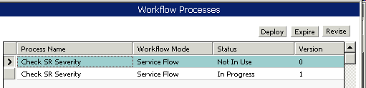
Versioning
Revision process:
  Select the Workflow Process record to be revised
  Click Revise
  Click Deploy to complete the process and make it available for activation in the client application
  Version automatically updates
Activation process in the client application is the same
Expire a process to make the current version unavailable to run
Notes:
Versioning is used to track each iteration of a workflow process.
After creating the workflow, press the Deploy button. To revise the process, press the Revise button. This allows editing of the process while the old version of the process can still be invoked. Once editing is completed, press Deploy. Clicking the Expire button will cause the current version to be unavailable to run.
In the client, the revised version of the workflow is available for activation while the old version is still running. Once the new version is activated, the old version is given the status "Outdated" and the new version shows as "Active."

Slide 22
Migrating Workflow Definitions
Export-Import utility provided by Workflow
  Used for migrating individual or small sets of workflows between environments
  Uses Siebel Tools to export from one environment and import into another environment
  No export/import available from runtime client
REPIMEXP utility
  Exports the entire repository, not just Workflow objects
  Does not allow selective choosing of repository objects
Notes:
Once you have deployed Workflows to a test environment, and then completed your testing, you have two choices for migrating Workflow processes to the production environment. If you simply need to export one or few Workflow processes between environments, use the Export-Import utility provided with Workflow. This utility is available only in Siebel Tools to export and import workflows, not in the runtime client. To export multiple workflows while using this utility, hold down the CTRL key as you select the processes you want to export.
In cases where you need to migrate the entire repository between environments, use the standard REPIEXP utility found in the siebel/bin directory. This utility migrates everything in the repository and does not allow for selective choosing of repository objects. This utility might also be required if Siebel Tools is not linked to the production environment which would restrict you from using the Workflow utility in Siebel Tools to migrate Workflow processes to production.

Slide 23
Summary
This module showed you how to:
  Describe the simulation architecture
  Test a Workflow process using the simulator
  Describe the steps for deploying a Workflow process
Notes:
Review Question: When simulating a workflow process, how does the Simulator know which data to use in the simulation?
Answer: The developer creates a test record in the client application and uses the row ID for that test record as the Default String value for the Object ID process property.
Review Question: When following best practice, what does the developer do first, check in the workflow project, or click the Deploy button to mark a process "Completed?"
Answer: The developer should first click the Deploy button so that when the project is checked in, the workflow process shows up as Completed. This means that when the developer goes back to their local environment in Tools, any workflow projects that are checked out are assumed incomplete, and any that are checked in are assumed completed.
Review Question: What screen does the administrator select to view processes that need to be activated?
Answer: Administration - Business Process > Workflow Deployment shows the repository of workflow processes that are available to be activated. The top applet has the Activate button. The bottom applet displays the active workflow processes.
Review Question: What is the best way to migrate five workflow processes within a single project to the server production environment from the local development environment?
Answer: When just a few workflow processes need to be moved to production, the developer can select each workflow process record in the OBLE, then use right-click Export Workflow Process to create an .xml file that contains the definitions for each process. The developer then logs in to the Server environment in Siebel Tools, selects Workflow Process in the OE, right-click the OBLE and selects Import Workflow Process.

Slide 24
Lab
In the lab you will:
  Validate, simulate, deploy, and activate a Workflow process
Notes:
See the lab instructions for details.
Labs and Troubleshooting: The first time students run the simulator, the process does take some time. They may see a timeout window (instructions to look for this are provided in the lab) and if so, have them just click OK and continue to wait as needed. Students might begin to notice, depending on the number of times they run the Simulator, that the process becomes a little faster each time.
Please note: There is not a solution document for lab 40-2.

